Slide 1


Life, Career and Beyond
Presented by Kiefer Consulting, Inc.
Notes:
Common Sense vs. Common Practice: Some of the things I will talk about as it relates to your job search and career will seem like common sense.
But the reason I have to talk about these thing is because common sense is not always common practice.

Slide 2

Gregory Kiefer, CEO
President and CEO of Kiefer Consulting
Established consulting services company in 1988 at the age of 26
Built a consulting firm that continues to grow, learn and adapt

Slide 3




What do we do?
Modern
Workplace
Our Modern Workplace practice develops and deploys innovative solutions that improve how organizations communicate and share information both internally and externally as well as workflows, robotic process automation & data collection.
Data Analytics & Visualization
Our Data Analytics & Visualization practice builds sophisticated, yet practical tools that allow organizations to better interact with their data and enables the extraction of meaningful insights. Data visualization, transformation & data warehousing.
Data Migration &
Cloud Services
The Data Migration and Cloud Services (AI, ML) practice has expertise in helping organizations move data to the cloud as well as determining what applications could benefit from cloud-hosting.
Program & Project Management
With deep-expertise in program and project control, the Construction Management practice helps organizations improve the management of information with feature-rich reporting capabilities.

Slide 4
Career in Consulting
Why?
Diversity of clients and industries
Variability of business and technical challenges to solve
Opportunity for personal growth and investment
Opportunity to have a positive impact
Satisfaction of knowing that you were able to help someone
Creativity and diversity of teams
Opportunity to define your own destiny
Opportunity to participate in building a company that shares your values for integrity, delivery and customer satisfaction
Possibly more money

Slide 5
Guiding Principles
My Guiding Principles
Integrity
Compassion
Lifelong Learning
Being Kind to Others
Giving Back
Value Oriented
Risk Taking
Help Others Achieve the Unexpected
Adaptability
Diversity (thinking, culture, opinions…)
“Guiding Principles are a set of statements which expresses your personal ideals and values. These values are essentially what shapes your framework for how you make your choices in life, your direction, and where your personal limits or sense of personal morals or ethics might be.” Wikipedia
“I created Kiefer Consulting, because the industry I was working in did not align with my principles. I wanted to change the industry.”

Slide 6

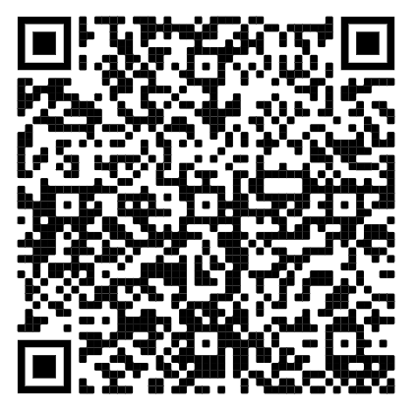
Guiding Principles
What are some of your guiding principles?
Guiding Principles Survey
How do they impact your job search?
What happens if you compromise any of them to get a job?

Slide 7

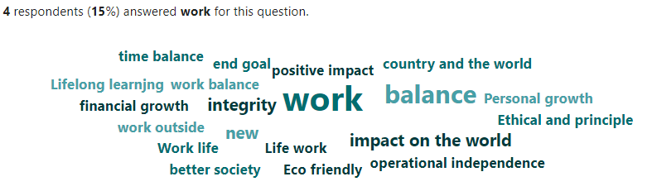
Results

Slide 8
Tell your story with a purpose
Make your story personal
“Some characteristics of a position I am looking for include the opportunity to utilize my skills, and personal and professional growth. I also value the significance of the tasks I complete, and how they affect my colleagues or clients. Lastly, having the opportunity to progress in a position and learn or employ a variety of skills.
The purpose I envision in my next career would entail in the short term being a valued member of a team that can generate not only success for a client but continually supersede expectations. Long term, I have the desire to lead such a team. ” Zara.
Be prepared to tell your story during the first part of the interview.
Be prepared with an interview closing statement. You want to be remembered in a positive way.

Slide 9
The New Workforce: Location
Onsite
Hybrid
Remote
Which option works best for you? Why?

Slide 10

The New Workforce: Engagement
Advancing your in career:
Stay engaged
Be productive
Be responsive
Do your job
Take ownership
Advance your skills
Take on new responsibilities
Stay visible

Slide 11
The New Workforce: Corporate Culture
When applying for a job, research the company thoroughly.
Have they adapted?
How do they engage their new workforce?
Ask the interviewer what it is like working for the company today versus before the pandemic.
How does someone succeed at your company?
Why is this important?
Employees need to feel like they are part of something bigger, something that is relevant, someplace where their contributions matters.
They also want to be recognized for their work efforts.

Slide 12
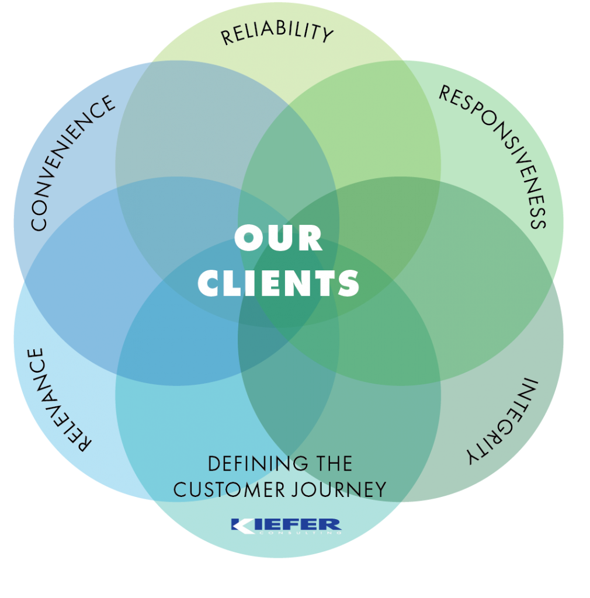
I landed the job. Now what?
“The customer experience is the cumulative impact – both emotionally and practical – of all of the encounters and interactions that a customer has with a company.” Customer Experience Edge
Our guiding principles:
Reliability – Live up to our promises.
Convenience – Offer choice, consistency and timeliness.
Responsiveness – Listening and responding quickly.
Relevance – Offerings are personalized and meaningful.
Integrity – Be honest with our customers.
Presence – Need to maintain a presence with customers
At Kiefer Consulting: “We want our customers to have an amazing experience working with the Kiefer team: The Kiefer Experience”

Slide 13


How will you stay engaged?
Career Success Factors

Slide 14
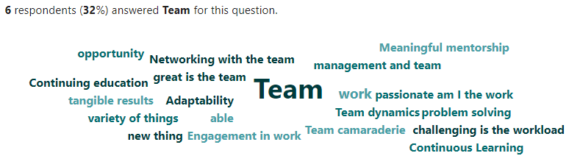
Results

Slide 15
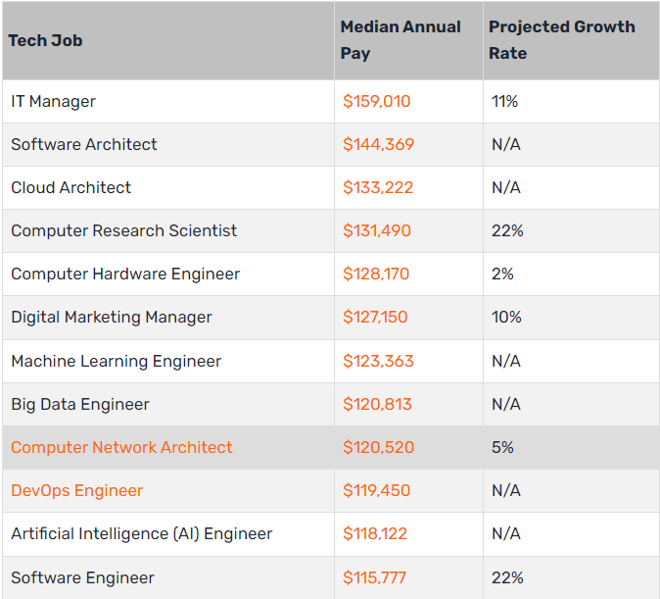
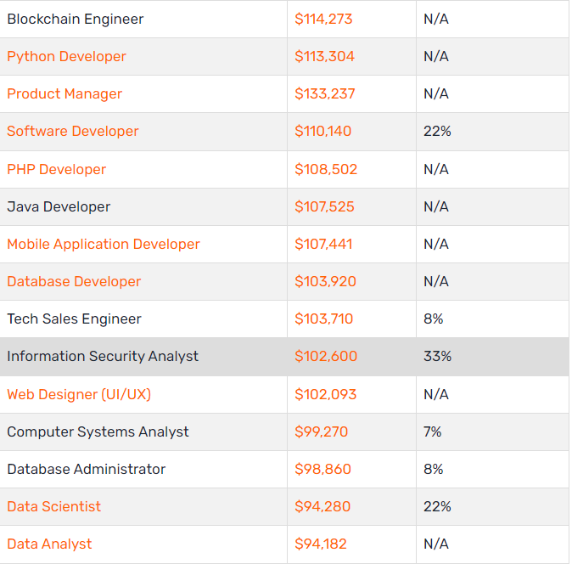
Best Tech Careers 2022
Source: Best Tech Jobs (careerkarma.com)

Slide 16
Five Ways AI will impact the workforce
It will unleash our creativity: DALL-E 2, MidJourney, ChatGPT
It Will Make Coding Much More Accessible
It Will Become Our Copilot in Other Ways Too
It Will Unlock Faster Iteration
It Will Make Work More Enjoyable
“I think with some confidence I can say that 2023 is going to be the most exciting year that the AI community has ever had,” Kevin Scott, chief technology officer at Microsoft
Article Source

Slide 17
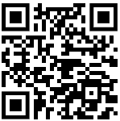
Impact of AI
Impact of AI Survey

Slide 18
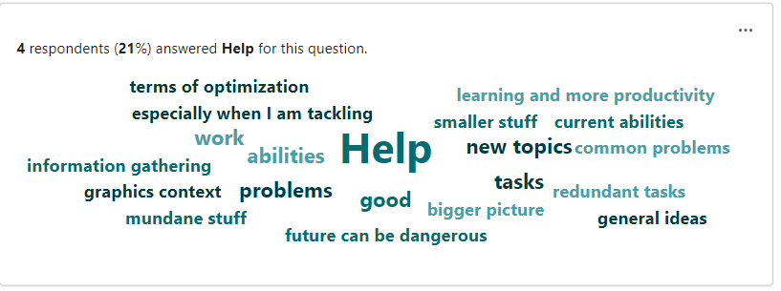
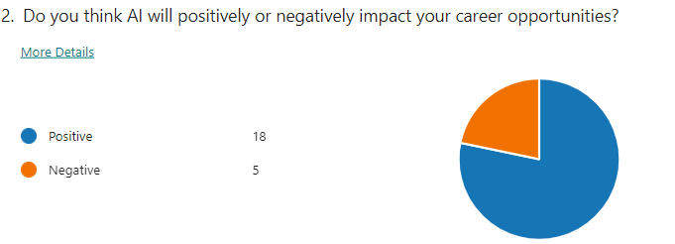
Results

Slide 19
Fears
Getting too many reject letters
Not interviewing well
Being nervous when talking with employers
Moving to a new location
Not being good enough
Not having enough experience
Failing
What other fears do you have at this point in your career?

Slide 20

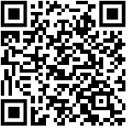
Last words of advice
Build a network that will help you achieve your goals while helping support other with theirs.
Watch the “Designing the Life you Want” Ted talk
Do something positive for someone this week. It will change the world.
University Enterprises Inc

Slide 21


Questions & Answers

Slide 22
Contact Information
Gregory Kiefer
CEO
KIEFER CONSULTING, Inc. 13405 Folsom Blvd., Suite 501, Folsom, CA
(916) 932-7220 (office)
(530) 350-9129 (Google Voice) gkiefer@kieferconsulting.com

Slide 23

Remote Job Interview Questions
When working remotely, what key factors contribute to ensuring a successful workday? What steps do you take ensure limited distraction, productivity and continued success?
What are some of the biggest challenges you face today working remotely?
Describe how you will maintain company and customer confidential information, including online meetings, when working remotely.
When you’re working with many customers, it’s tricky to deliver excellent service to them all. How do you go about prioritizing your customers’ needs?
Tip: Leverage the “Coach” feature in PowerPoint to rehearse your answers to potential questions.
Tip: Have more than one person read your resume.
We have revised our interview questions to better assess a potential remote worker.

